Slide 1
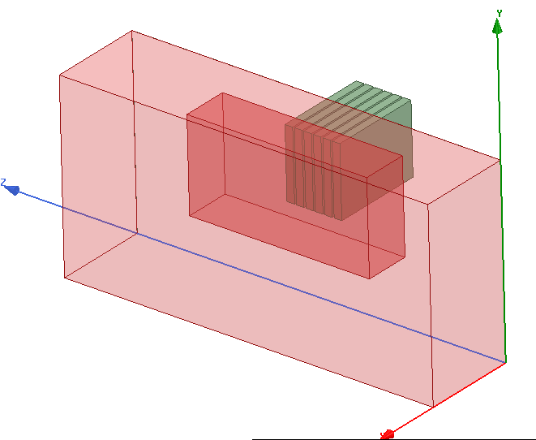
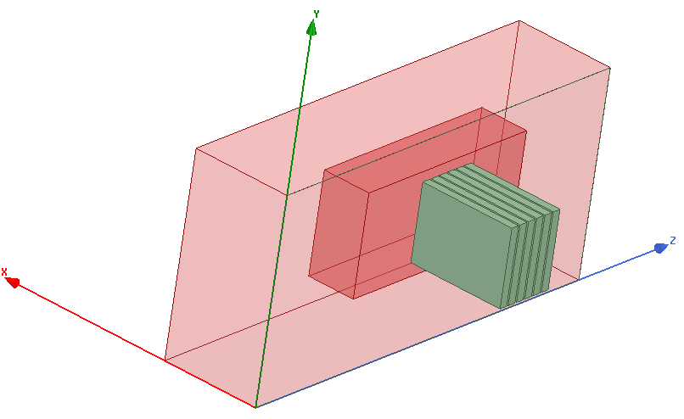
6 waveguides
3.7 GHz
d_gap vacuum
Ne₀=N x Ne_{c}
1 gradient de lambda

Slide 2
Permittivity :
1, 1, 1-$N_nc*(1+(X-$dgap)*1e-3/$L_n)
Losses in conductivity:
if(X>10e-3, $loss_factor*(X - 10e-3)^2, 0) + if(Z>180e-3, $loss_factor*(Z - 180e-3)^2, 0) + if(Z<40e-3, $loss_factor*(-Z +40e-3)^2, 0)

Slide 3
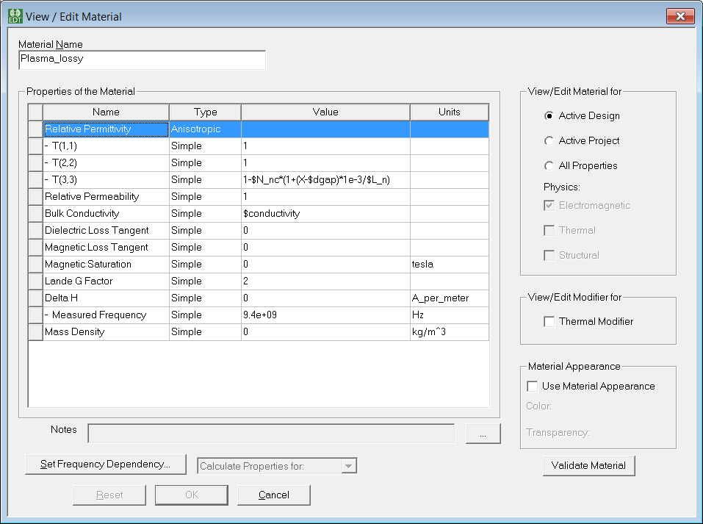

Slide 4
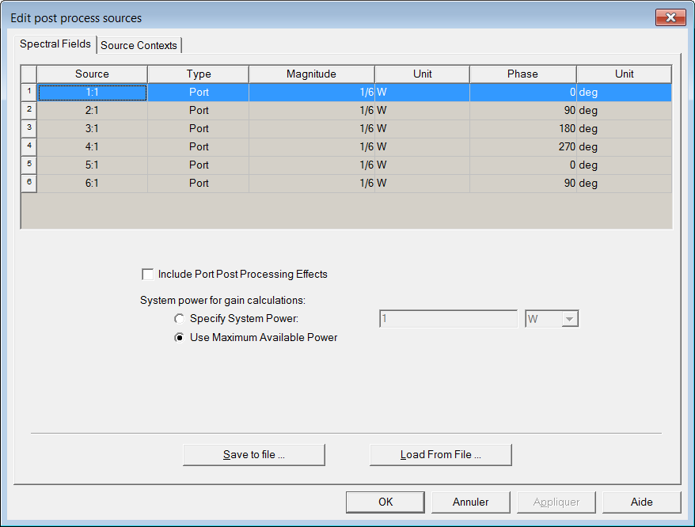
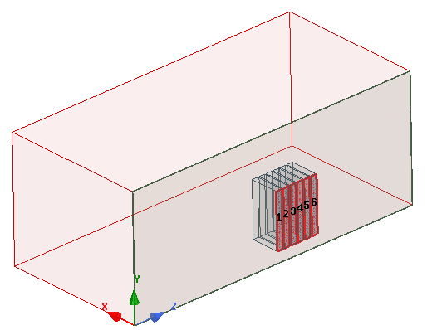
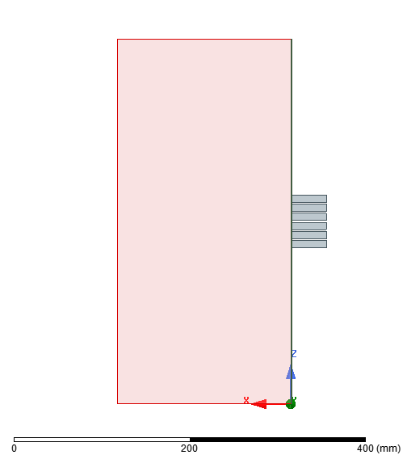
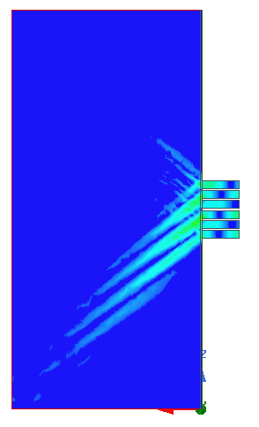

Slide 5
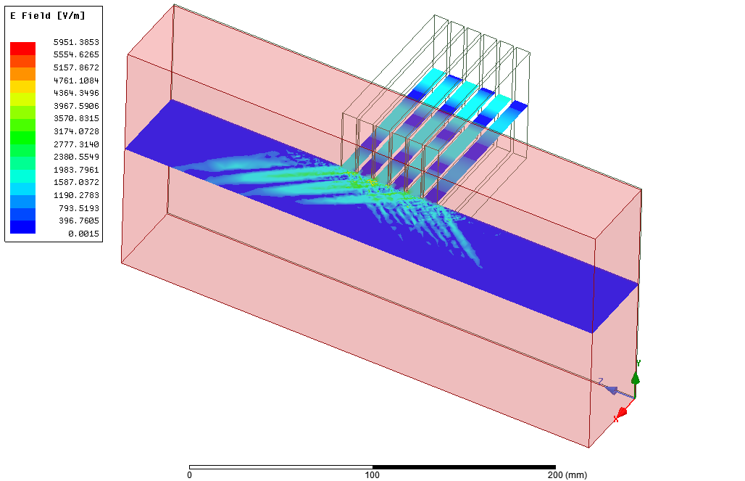

Slide 6
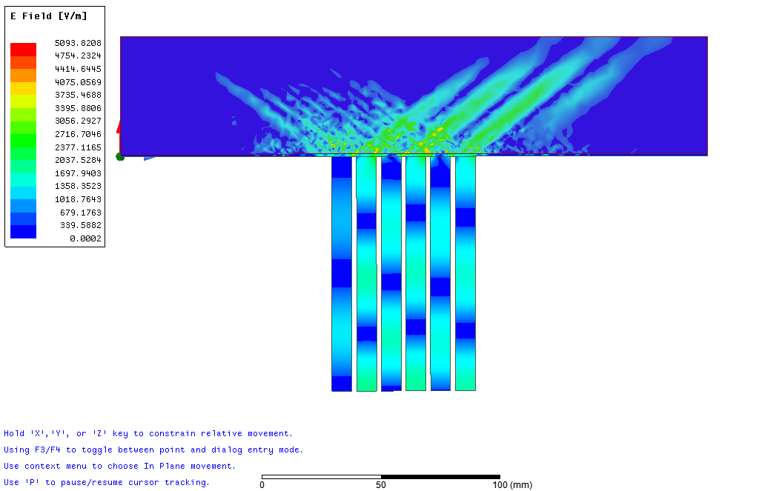
Lin scale 3nc, Ln 1cm, 1mm gap
128 000

Slide 7
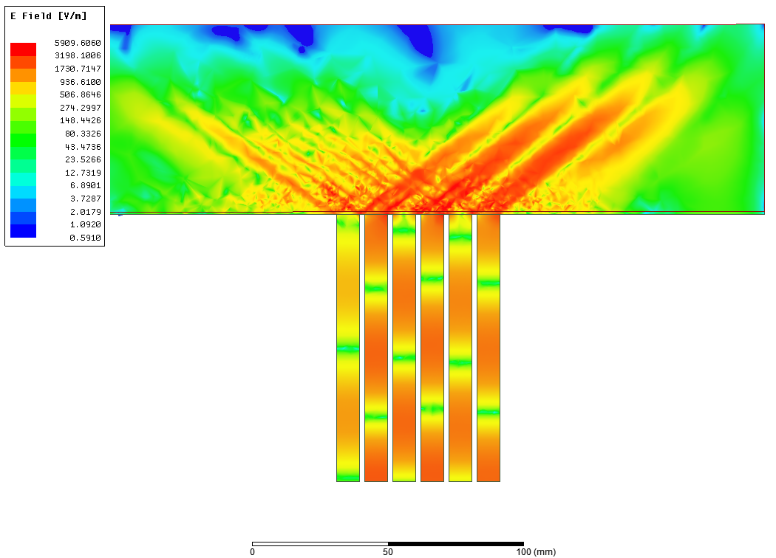
Log scale 3nc, Ln 1cm, 1mm gap
128 000

Slide 8
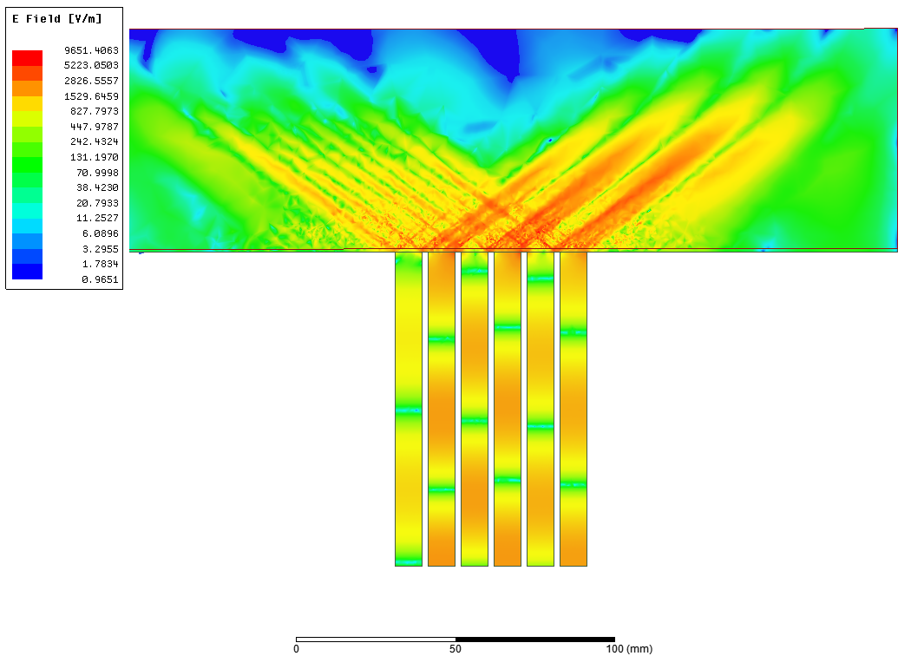
Log scale 3nc, Ln 1cm, 1mm gap
340 000

Slide 9
Log scale 3nc, Ln 1cm, 1mm gap
340 000

Slide 10
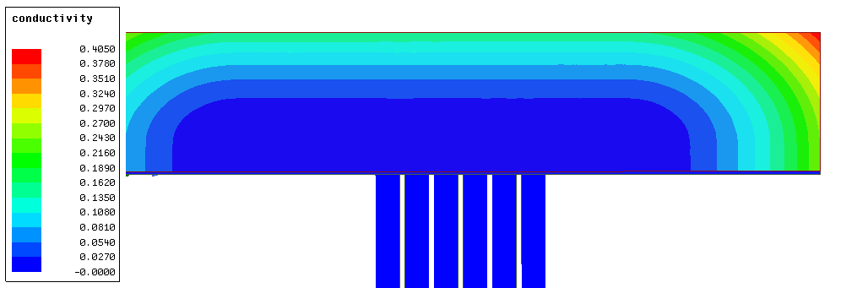
No loss region

Slide 11
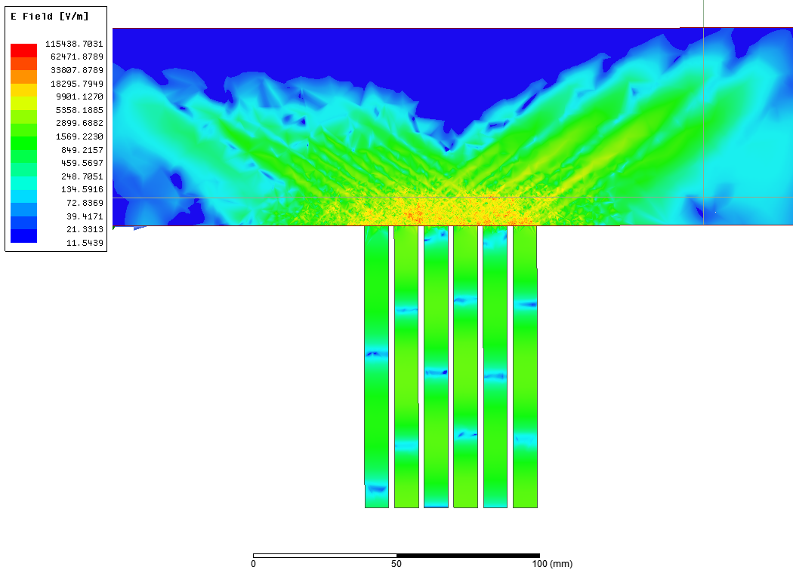
Plasma directly, high convergence

Slide 12
